Slide 1
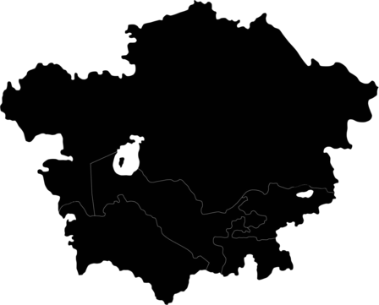
INCREASING POVERTY –
THE IMPACT OF RUSSIAN-UKRAINIAN WAR ON CENTRAL ASIA
Muhayyoi Rahimzoda
Ph.D. Candidate | World Economy Department |
Institute of International Relations and Political Science|
Corvinus University of Budapest |Hungary
muhayyoi.rahimzoda@gmail.com

Slide 2
Structure
01
02
04
Central Asia (CA)
Russia and Central Asia
Mitigating risks
03
War consequences for CA
STRUCTURE
RUSSO-UKRAINIAN WAR
REMITTANCES
RISK MITIGATION
CENTRAL ASIA
TRADE AND FOOD

Slide 3

Central Asia - General information
6.2%
77m
347b
POPULATION 2021
GDP 2021
2021
0,7%
average annual GDP growth rate in the Central Asian countries over the last 20 years
Share in world GDP
Challenges:
► Lack of access to the sea
► Resource dependence and low level of financial development
► Lack of coordination in the water and energy complex
► Climate change and environmental damage
STRUCTURE
RUSSO-UKRAINIAN WAR
REMITTANCES
RISK MITIGATION
STRUCTURE
CENTRAL ASIA
TRADE AND FOOD

Slide 4


The Russo-Ukrainian war
Europe
9,2%
Poverty rate
71 m
people
Central Asia
Middle East
Close economic, political and cultural ties
Non-commodity exporters - Kyrgyzstan and Tajikistan
Africa
Poverty:
Remittances
Trade and food security
STRUCTURE
RUSSO-UKRAINIAN WAR
REMITTANCES
RISK MITIGATION
STRUCTURE
CENTRAL ASIA
TRADE AND FOOD

Slide 5





Remittances
Remittance dependent countries
Remittances received % of GDP
Money transfers - only source of
income
5m
Contribute to poverty reduction
Remittances spent on basic needs – food and healthcare
Source: World Bank Indicators
Russia – main destination (90%)
STRUCTURE
RUSSO-UKRAINIAN WAR
REMITTANCES
RISK MITIGATION
STRUCTURE
CENTRAL ASIA
TRADE AND FOOD

Slide 6
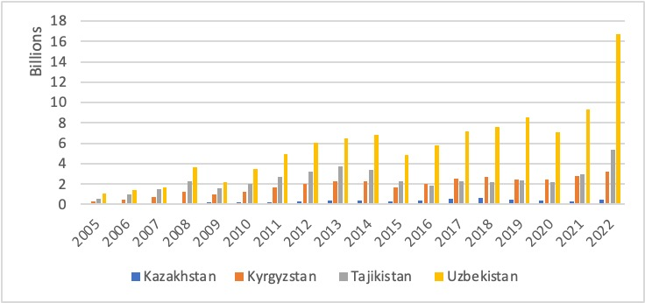
Remittances (1)
Russian migrants, companies and capital migration, migrant workers who have liquidated their wealth and collected their earnings
Sanctions and Russian labour market
Decline in number of workers and salaries
Remittances received, 2005-2022, billions dollars
Risk of being taken to the army
Source: World Bank Indicators
STRUCTURE
RUSSO-UKRAINIAN WAR
REMITTANCES
RISK MITIGATION
STRUCTURE
CENTRAL ASIA
TRADE AND FOOD

Slide 7
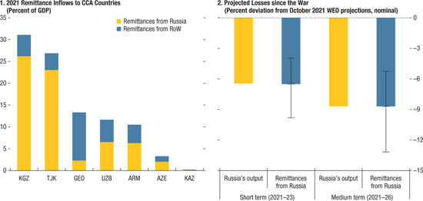

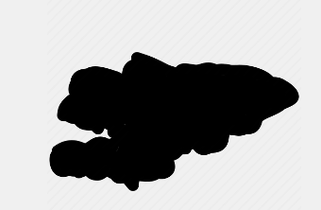
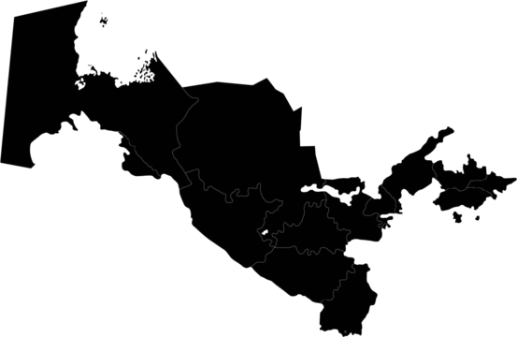
Remittances (2)
Projected losses since the war
5-13%
projected decrease
IMF, 2022
1 million forced into poverty
IMF, 2022
22%
Source: IMF, 2022
33%
21%
Source: World Bank, 2023
STRUCTURE
RUSSO-UKRAINIAN WAR
REMITTANCES
RISK MITIGATION
STRUCTURE
CENTRAL ASIA
TRADE AND FOOD

Slide 8



Russia and Central Asia – Trade relations
01
02
03
04
Least integrated into global market
Limited trade partners
The share in global market is only 1%
Russia, China and Turkiye
Russia as a largest importer and exporter
Heavily relies on routes through Russia
Businesses are forced to deliver viral goods - seeds, fertilisers, production resources, raw materials via different routes which made logistics and insurance costs much higher
Largest importer for all CA (except for Kyrgyzstan where Russia ranks second behind China).
Largest destination of export for Kyrgyzstan and second for Kazakhstan and Uzbekistan
STRUCTURE
RUSSO-UKRAINIAN WAR
REMITTANCES
RISK MITIGATION
STRUCTURE
CENTRAL ASIA
TRADE AND FOOD

Slide 9






Food security – Global food market
Ukraine:
Share in world export in 2019, %
Blocked 7 out of 13 of Ukrainian ports
Destroyed grain storage facilities
Shutting down of fertilizer plants
Farmers joined the army and left their lands
Source: World Economic Forum, 2022
Russia:
Sanctions and limitations
Banking limitations and inability to export fertilisers
“Breadbasket of Europe”
STRUCTURE
RUSSO-UKRAINIAN WAR
REMITTANCES
RISK MITIGATION
CENTRAL ASIA
TRADE AND FOOD

Slide 10
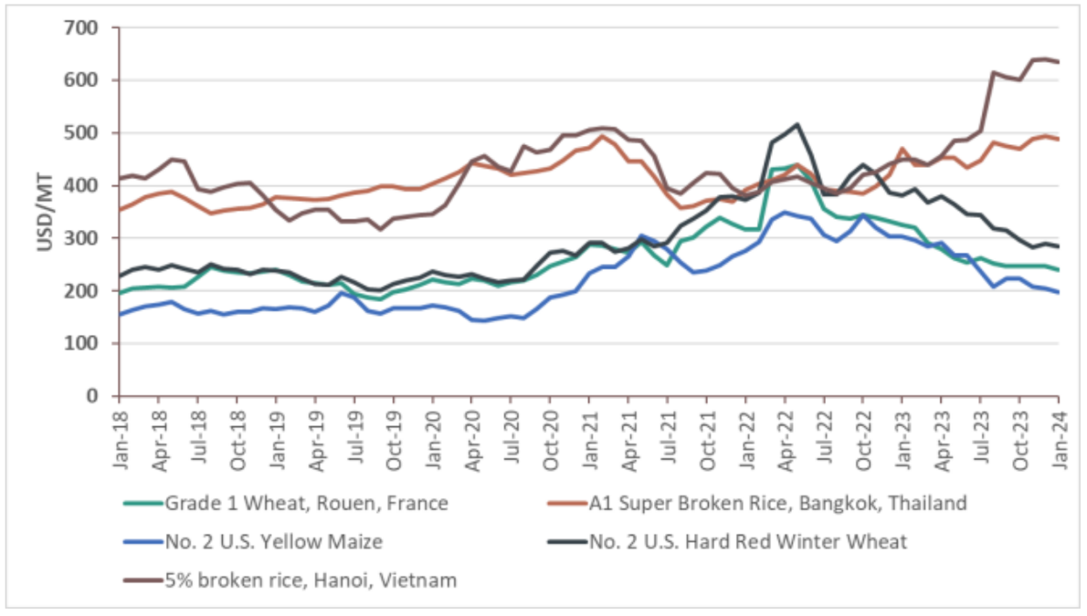
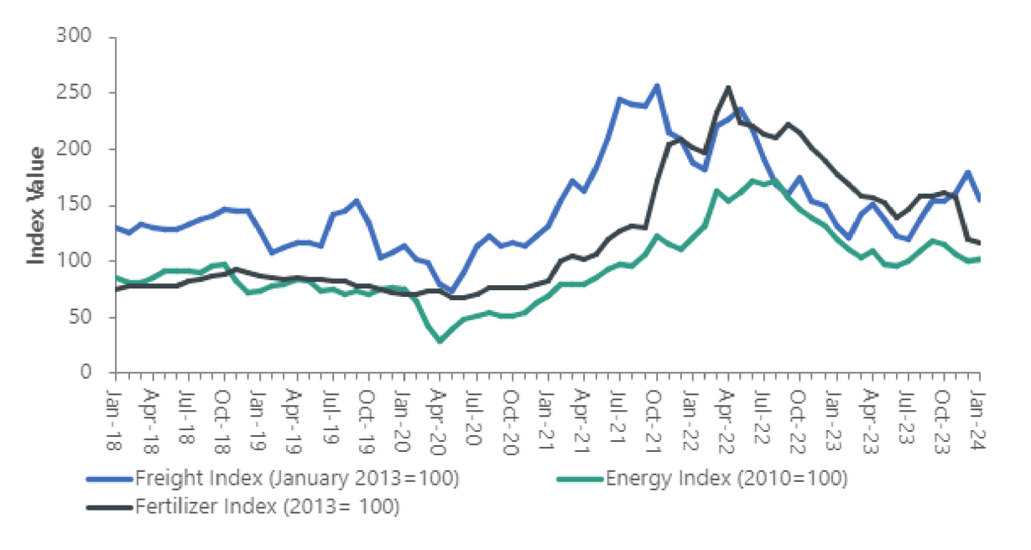
Food commodity prices in selected international markets. January 2018 – January 2024
International Energy, Fertilizer, and Freight Cost Indices. January 2018 – January 2024
Source: Food and Agricultural Organization of the United Nations (FAO), World Bank.
Source: International Grains Council and World Bank.

Slide 11



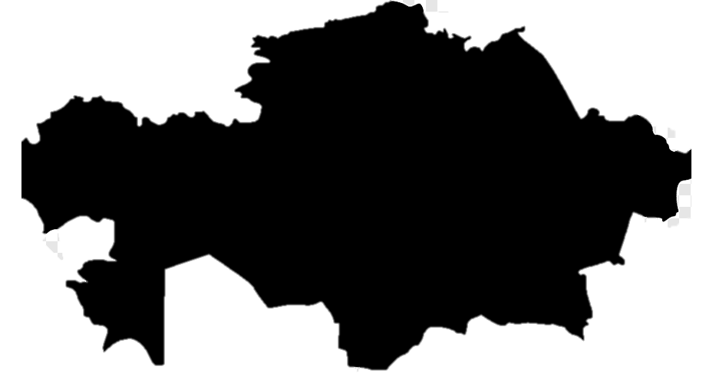
Central Asia and food crisis
Dependence on Ukranian and Russian wheat
100% wheat imported from Russia in 2020
Bread – 25-30%
Sugar, meat eggs – 40-50%
Energy resources – 200%
55% wheat imported from Russia in 2021
Food prices increase since 2019 - 50%
70% of income is allocated to food expenses
Surging food prices can be life-threatening for many families
Overall inflation – 20.3%
Food prices increase – 13.5%
Overall inflation – 12%
STRUCTURE
RUSSO-UKRAINIAN WAR
REMITTANCES
RISK MITIGATION
STRUCTURE
CENTRAL ASIA
TRADE AND FOOD

Slide 12
Risk mitigation
01
02
04
Diversification of trade partners and trade routes
Diversification of migration destination
Adjusting to new realities and using the opportunities
03
Regional cooperation and integration
STRUCTURE
RUSSO-UKRAINIAN WAR
REMITTANCES
RISK MITIGATION
STRUCTURE
CENTRAL ASIA
TRADE AND FOOD

Slide 13
Questions
Comments
Discussion

